Slide 1
GLOBAL NEXT CONSULTING INDIA PRIVATE LIMITED
Summer Internship Program in AI & ML
MINI PROJECT REPORT
Presented By
Phishing Incident Report Analysis
Prayas Palit
Finding null values, duplicate URLs, cleaning the data, and creating simple visualizations
Roll No
B230058EC
Domain
Cybersecurity
Dataset Source
PhishTank public verified online phishing URL feed
Tools Used: Python, Pandas, Matplotlib, Jupyter Notebook / VS Code

Slide 2
Dataset And Objective
Week 1 | GNCIPIL
Understanding the data before writing analysis code
What the dataset contains
file_path = r"E:\\GNCIPIL\\WEEK 1\\phishtank_online_valid.csv"
df = pd.read_csv(file_path)
print("Dataset loaded successfully.")
Each row represents one reported phishing URL.
The url column stores the suspicious phishing link.
The target column stores the brand or service being targeted.
Phishing URLs should not be opened because they may be unsafe.
Main aim
Find null values, identify duplicate records, clean the dataset, and perform simple analysis using Pandas and Matplotlib.
Item
Value
phish_id
Unique phishing report ID
url
Suspicious phishing link
submission_time
When report was submitted
verified
Whether report was verified
target
Brand or service attacked

Slide 3
Loading And Inspecting Data
Week 1 | GNCIPIL
Basic commands used before cleaning the dataset
print("First 5 rows of the dataset:")
print(df.head())
print("Number of rows and columns:")
print(df.shape)
print("Column names:")
print(df.columns)
Output Summary
Rows
Columns
63,956
8
Why this step is needed
Before cleaning, we first check what the data looks like, how many rows and columns are present, and what column names are available.
This is similar to opening the dataset and checking its structure before doing any data analysis.

Slide 4
Statistical Summary
Week 1 | GNCIPIL
Using describe() like the reference example
df["url_length"] = df["url"].str.len()
print("Statistical summary of numerical columns:")
print(df[["phish_id", "url_length"]].describe())
Item
Value
count
63,956 URLs
mean length
57.99 characters
minimum
12 characters
median
38 characters
maximum
25,523 characters
Meaning
url_length is a new column that counts how many characters are present in each phishing URL.
Important Observation
Most URLs are not very long, but a few extreme phishing links are much longer than normal.
This helps us understand whether phishing links are usually short, medium, or very long.

Slide 5
Null Value Checking
Week 1 | GNCIPIL
Checking if the dataset has missing values
print("Null values in each column:")
print(df.isnull().sum())
print("Total null values:")
print(df.isnull().sum().sum())
Total null values
0
Rows with nulls
0
What it means
isnull() checks missing values.
sum() counts missing values.
No rows were removed due to null values.
In this dataset, no null values were found.

Slide 6
Duplicate Checking
Week 1 | GNCIPIL
Finding repeated rows and repeated phishing URLs
duplicate_rows = df[df.duplicated()]
duplicate_urls = df["url"].duplicated().sum()
duplicate_url_rows = df[df["url"].duplicated(keep=False)]
print(duplicate_urls)
Complete duplicate rows
0
Duplicate URLs
7
Meaning of keep=False
It shows all rows where the URL is repeated.
This helps us see both duplicate copies clearly.
The duplicate URL rows are removed in the next step.

Slide 7
Cleaning The Dataset
Week 1 | GNCIPIL
Removing duplicate URLs and null rows
df_no_duplicates = df.drop_duplicates(subset=["url"], keep="first")
clean_df = df_no_duplicates.dropna()
clean_df = clean_df.copy()
Rows before cleaning
63,956
Rows after cleaning
63,949
Why url is used for duplicate removal
The same phishing URL should not be counted repeatedly. So duplicate records are removed based on the url column.
Rows removed
7
Target names can repeat because many URLs can attack the same brand.

Slide 8
Final Check After Cleaning
Week 1 | GNCIPIL
Confirming the cleaned dataset is actually clean
print(clean_df.isnull().sum().sum())
print(clean_df["url"].duplicated().sum())
print(clean_df.duplicated().sum())
Final null values
0
Final duplicate URLs
0
Final result
No null values remain.
Final duplicate rows
0
No duplicate URL values remain.
The cleaned dataset is ready for analysis.

Slide 9
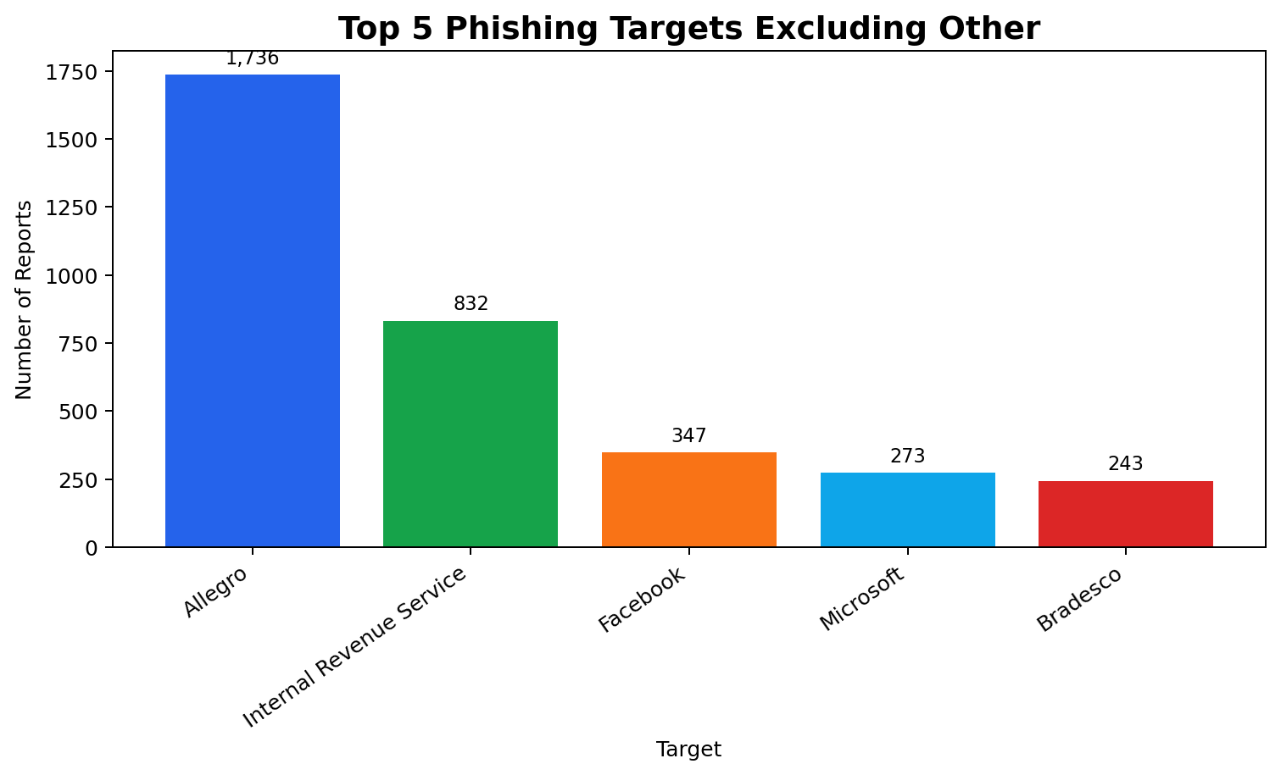
GroupBy Analysis
Week 1 | GNCIPIL
Top phishing targets after removing Other
target_data = clean_df[clean_df["target"] != "Other"]
target_reports = target_data.groupby("target")["url"].count()
target_reports = target_reports.sort_values(ascending=False).head(5)
print(target_reports)
Item
Value
Allegro
1,736
Internal Revenue Service
832
Facebook
347
Microsoft
273
Other was removed from the chart because it is too general and hides the meaningful brand names.
Bradesco
243

Slide 10
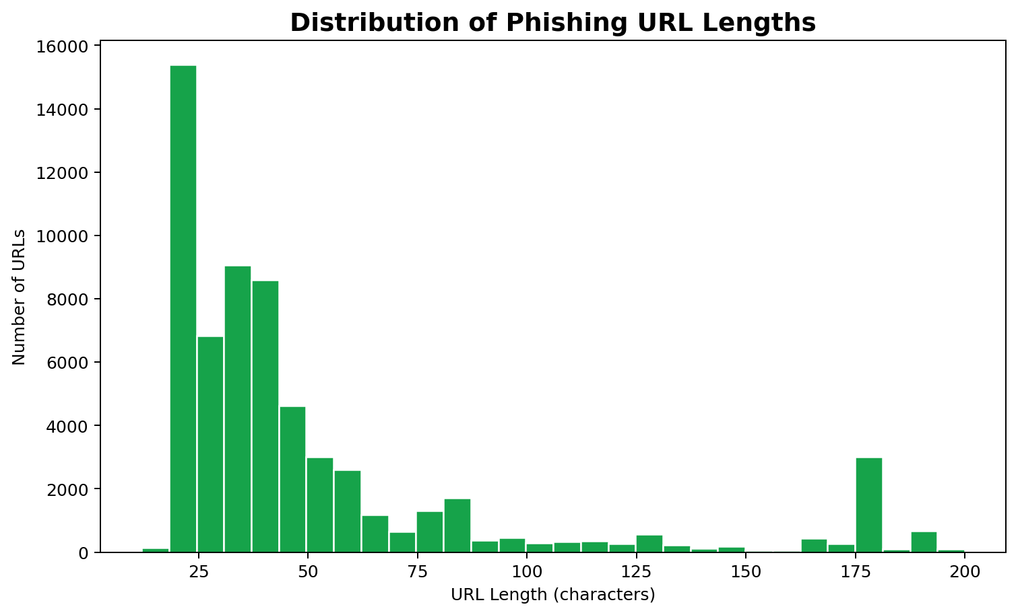
URL Length Visualization
Week 1 | GNCIPIL
Simple histogram for phishing URL length
url_length_chart_data = clean_df[clean_df["url_length"] <= 200]
url_length_chart_data["url_length"].plot(kind="hist", bins=30, color="lightgreen")
plt.title("Distribution of Phishing URL Lengths")
Why this visualization is useful
It shows how long phishing URLs usually are.
Very long URLs can be suspicious or confusing.
The chart is limited to URLs up to 200 characters so it is readable.

Slide 11
Save Output And Conclusion
Week 1 | GNCIPIL
Final deliverables created from the cleaned data
cleaned_file_path = r"E:\\GNCIPIL\\WEEK 1\\cleaned_phishtank_dataset.csv"
clean_df.to_csv(cleaned_file_path, index=False)
Saved File
cleaned_phishtank_dataset.csv
Conclusion
Main learning
The real PhishTank dataset was loaded using Pandas.
This project shows how to perform beginner-level data preprocessing and visualization on a real cybersecurity dataset.
Null values and duplicate values were checked clearly.
7 duplicate URL records were removed.
A statistical summary and two simple charts were created.

